Slide 1
Reverse mentoring
Professor Sally Curtis & Jacquie Kelly
School of Primary Care, Population Sciences and Medical Education, Faculty of Medicine

Slide 2
Rationale and definition
Students from minority backgrounds frequently struggle to fit in to medical schools and find their sense of belonging and identity¹
An attainment/awarding gap, found across HE and medical training, affects students from racially minoritised and/or low socioeconomic backgrounds²⁻⁵
Reverse mentoring is an inversion of the traditional mentoring model. It encourages meaningful conversations between mentors who would normally be considered junior and less experienced in a particular field, and mentees, who are typically regarded as more experienced or senior.
Notes:
Sally 5 minutes

Slide 3
Aims of the scheme
Increase understanding of the challenges faced by learners from minority groups
Raise awareness of and challenge exclusion and inequity
Create an inclusive learning and working environment for learners and educators
Reduce the attainment gap for learners from minority groups
Raise awareness of institutional responsibility
Notes:
Sally 1 minutes

Slide 4

So far…
Mar – Jun 2020: Piloted in the Faculty of Medicine with 8 mentor mentee pairs
Mar – Jun 2021: Run in Faculty of Medicine with 10 pairs
Oct 2021- Jan 2022: Run in UHS in collaboration with the UG and PG DMEs, with 7 pairs
Also run with Southampton’s University Executive Board,
Bristol Medical School and Leicester Medical School
Notes:
Sally 1 minutes

Slide 5
Structure of the scheme
Safe Space
Initial training
(mentors / mentees)
Mentors’ handbook
Structure and support
Students as educators
Staff as active listeners
Mid-way support session
(mentors and mentees)
4 meetings
Challenging conversations
Evaluation sessions (mentees, mentors)
Evaluation questionnaires
Meaningful outcomes
Notes:
Jacquie 5 minutes Safety and well-being of all participants was crucial - creating safe spaces for the training sessions and the mentoring sessions.
Reversal of the power dynamic between students and senior staff
Difficult and challenging conversations around bias and discrimination could leave all participants in a vulnerable position.
Evaluation - outcomes

Slide 6
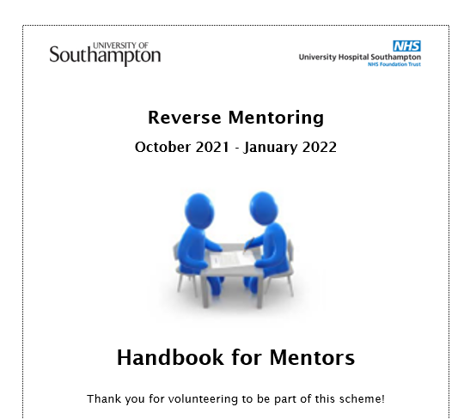
Session structure
Session 1
Confidentiality
Getting to know each other
Identifying objectives
How you will work together
Identity activity
Notes:
Handbook is a guide to help with structure and power reversal, the mentors adapt and make it their own

Slide 7
Inclusivity task
We interact with people from our own frame of reference, based on our values and biases
This can make it difficult to understand others if we are not familiar with their frame of reference.
Exploring your different cultural identities can help you to understand each other more and work more effectively together.
Notes:
Jacquie 1 minute
Exercise I learned from FT training

Slide 8
Inclusivity task - instructions
Individually, choose one aspect of your cultural identity and draw a picture or diagram to represent it (4-5 minutes)
In turn, tell your partner the story of the aspect you have chosen using your picture/diagram. Explain what is important to you and why. When you have finished, encourage them to ask one or two questions to develop their understanding.
Then swap round! (5 minutes each)
Notes:
3 minutes

Slide 9
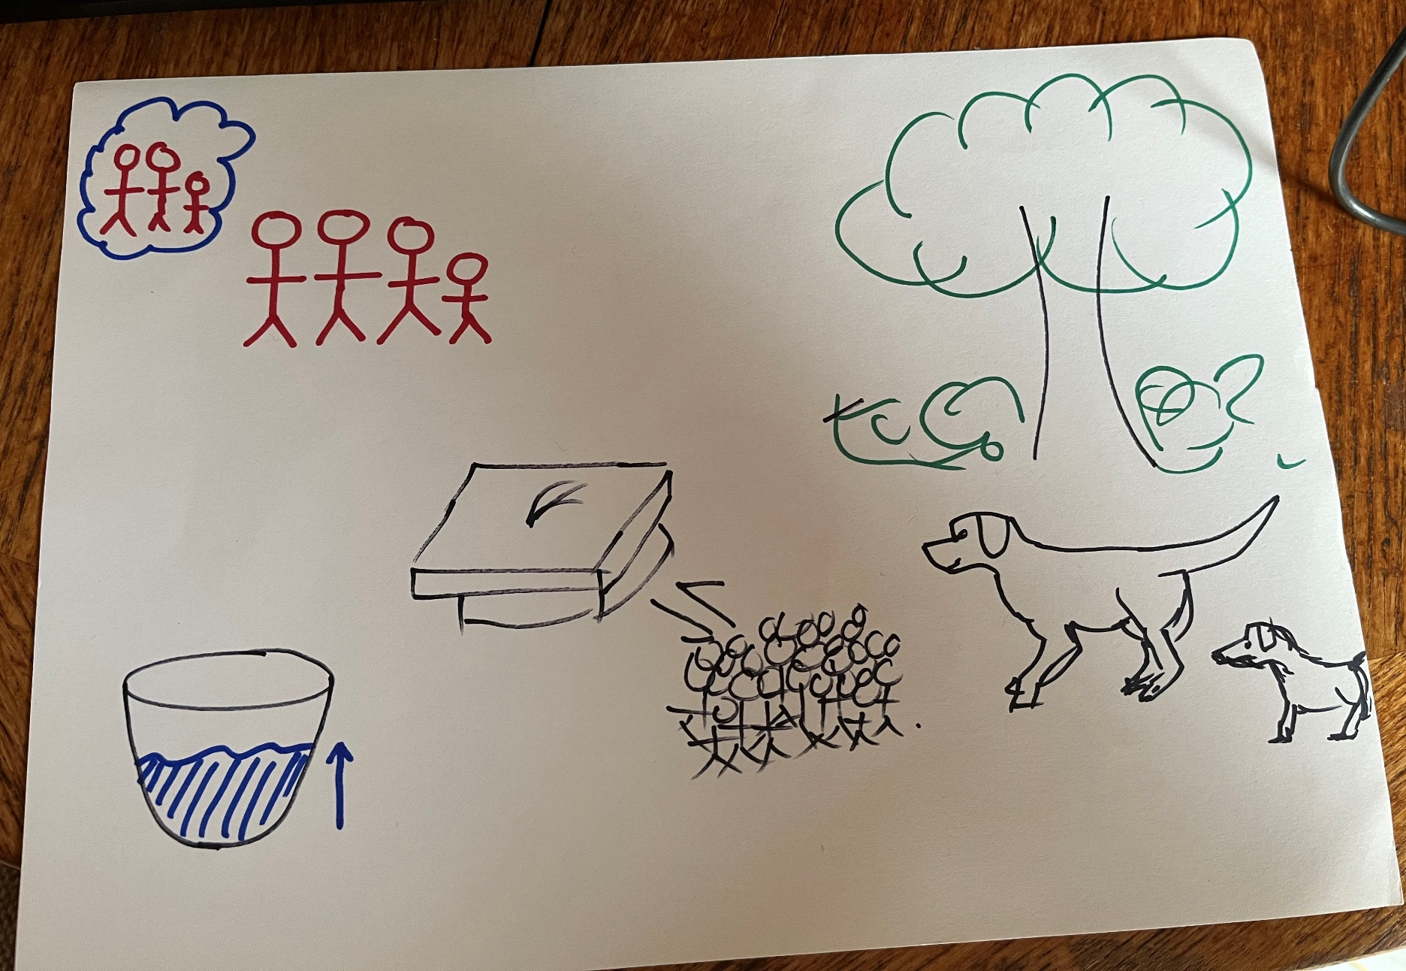
Sally’s example
Notes:
3 minutes

Slide 10
Feedback and debrief
*Without giving details of the conversation…
What did you learn?
Why do you think we suggest this activity in the first session?
Notes:
Together 5 minutes a couple of examples from audience
Designed to
increase self- awareness of the impact of individual cultural identity on personal bias
Prevent stereotypical assumptions
Building trust
Getting to know each other
Valuing diversity
Allowing the time and space to be heard

Slide 11
Sessions 2 - 4
Session 2
Privilege and intersectionality
Sharing experiences
Resources for session 2
Session 3
What is happening in this organisation?
Session 4
Did you achieve what you wanted to achieve?
Outcomes for future change
Further Information
Contact details
Student support
Report and Support

Slide 12
Examples of outcomes
Welcome and acknowledge all differences as part of introductions, to create a comfortable environment and a sense of belonging to the organisation
Increase awareness that learners can feel excluded from the team by cultural references, jokes etc, e.g., about use of alcohol.
Increase representation of LGBTQ+ people in clinical areas and depiction of positive images of LGBTQ people, e.g., on elderly care wards
Identify ways for clinicians/consultants to take notice of individual learners and how to engage people who aren’t engaging
Promote more conversation and encourage all staff to make the most of every encounter to chat and get to know students
Notes:
Sally 2 minutes

Slide 13
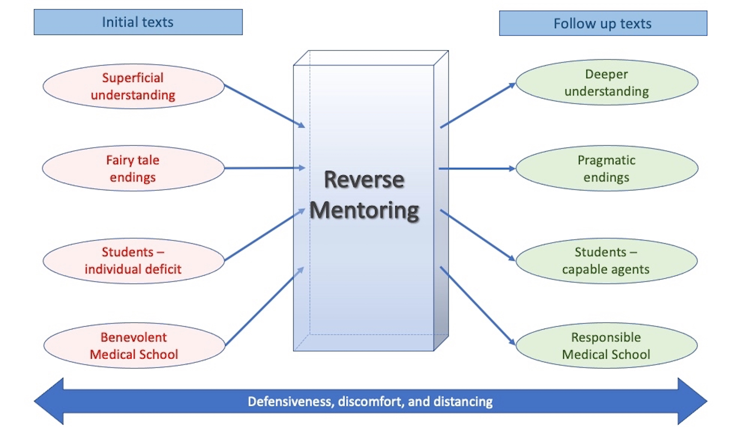
Evaluation⁶
Notes:
Sally 5 minutes

Slide 14
References
Mathers J, Parry J. Why are there so few working-class applicants to medical schools? Learning from the success stories. Medical Education. 2009;43 (3):219-228.
Morrison N, Machado M, Blackburn C. Student perspectives on barriers to performance for black and minority ethnic graduate-entry medical students: a qualitative study in a West Midlands medical school. BMJ Open2019; 9:e032493. doi:10.1136/bmjopen-2019-032493
Woolf K. Differential attainment in medical education and training. BMJ 2020; 368 doi: https://doi.org/10.1136/bmj.m339 (Published 11 February 2020)
Curtis S, Smith D. A comparison of undergraduate outcomes for students from gateway courses and standard entry medicine courses. BMC Medical Education. 2020; 20(1):4.
Curtis S, Smith D. A comparison of postgraduate outcomes for trainees from gateway courses and standard entry medicine courses. BMC Medical Education. In press.
Curtis S, et al. BMJ Open 2021;11:e054890.doi:10.1136/bmjopen-2021-054890

